Slide 1


Slide 2

Major Project-I (01CE0716)
Review 3 (30/08/2025)
CHILD VACCINATION TRACKER SYSTEM
Team ID: 089
Team Member 1: NUPUR SHINGALA (92310103002) (7TC2)
Guided By
Internal Guide Name: Prof. Aswathy Nair
Department of Computer Engineering, Faculty of Engineering & Technology

Slide 3
Outline
Abstract
Introduction
Literature Review
Tools & Technology
Problem Statement
Proposed System
Requirement Analysis
System Design & Implementation
Planning and Scheduling
System Design and Implementation
Project Screenshots
Conclusion
References

Slide 4
Abstract
The Child Vaccination Tracker System is a digital solution designed to help parents, caregivers, and healthcare professionals manage and track a child’s immunization schedule effectively.
Developed using Flutter with Firebase integration, the system ensures secure user authentication, real-time data storage, and cross-platform accessibility.
It allows users to register accounts, create baby profiles with essential details, and view personalized vaccination schedules based on the child's age.
The system sends timely reminders for upcoming vaccines, maintains a history of completed doses, and presents an intuitive dashboard with statistics on registered babies, vaccines given, and reminders set.
Additional features include access to doctor and hospital listings, notifications, and a responsive user interface optimized for both mobile and web platforms.

Slide 5
Introduction
The Child Vaccination Tracker System is a modern, user-friendly mobile and web-based application designed to assist parents, guardians, and healthcare professionals in efficiently managing and tracking a child’s vaccination schedule.
This system ensures that children receive timely immunizations by providing smart reminders, digital records, and insightful dashboards.
Built using Flutter and powered by Firebase, the platform offers a seamless experience for user registration, vaccine scheduling, baby profile management, and vaccination history tracking.
With features such as secure authentication, baby registration, vaccination reminders, doctor information, and real-time updates, the system bridges the gap between caregivers and healthcare, promoting public health awareness and reducing missed or delayed vaccinations.

Slide 6
Introduction
The Child Vaccination Tracker System is a modern, mobile and web-based app that helps parents and healthcare professionals manage child immunization schedules efficiently.
It ensures timely vaccinations by offering smart reminders, digital vaccine records, and user-friendly dashboards.
Developed using Flutter and Firebase, the system supports seamless user registration, baby profile creation, and vaccine history tracking.
Key features include secure login, vaccination reminders, doctor/hospital details, and real-time data updates.

Slide 7
Literature Review
Name | Type | Advantages | Disadvantages
1. VaccTrack | Mobile App | • Sends timely reminders for vaccinations/boosters. • Supports multiple profiles (children, elders, family members). | • Some features require internet (e.g., certificate verification). • Not connected with healthcare/government registries.
2. CANImmunize | Mobile App | • Export immunization records as PDF for schools, travel, or healthcare providers. • No need to carry physical records. | • Does not auto-fetch records from government databases. • Users must manually enter/request data.

Slide 8
Literature Review
Name | Type | Advantages | Disadvantages
3.Immunize Canada | Government-Linked Website (Canada) | • Includes seasonal updates (e.g., flu shots, COVID-19), keeping content current. | • Region-specific; schedules and resources tailored for Canada. • Less suitable for users outside Canada.
4.HealthyChildren.org | Educational Website | • Content written and reviewed by certified pediatricians, making it highly trustworthy. | • No built-in tracker or reminder system. • Purely educational; no user accounts or tracking features.

Slide 9
Literature Review
5. HealthyChildren.org – Vaccination Schedule
Website: https://www.healthychildren.org/English/safety- prevention/immunizations/Pages/default.aspx
Advantages:-
Content is written and reviewed by certified pediatricians, making it highly trustworthy.
Disadvantages:-
No Built-in Tracker or Reminder System
Does not offer user accounts or tracking features—purely educational.

Slide 10
Literature Review
6. Immunize Canada
website: https://immunize.ca
Advantages:-
Includes seasonal updates (e.g., flu shots, COVID-19), keeping the content current.
Disadvantages:-
The schedules and resources are tailored for Canada; not suitable for users outside the country without adaptation.

Slide 11
Tools & Technology
1. Frontend Development:
Flutter:
Framework for building cross-platform mobile apps using a single codebase.
Dart:
Programming language used with Flutter for UI and app logic.
2. Backend Services:
Firebase Authentication:
For secure user signup and login functionality (email/password).
Firebase Realtime Database:
For storing and retrieving user data, baby profiles, vaccine schedules, reminders, etc.

Slide 12
Tools & Technology
3. UI/UX Design:
Material Design Widgets:
Flutter’s built-in design system for responsive and consistent UI across devices.
Custom Theming:
Color schemes, cards, forms, and icons tailored to a pediatric and health-friendly theme.
4. Navigation & Routing:
Flutter Navigator 2.0 / Named Routes:
For navigating between pages like Login, Signup, Dashboard, Baby Profile, etc.
5. State Management:
StatefulWidgets / setState:
Used for simple state updates (like form validation and screen refresh).

Slide 13
Problem Statement
Parents often forget vaccination dates for their children.
Tracking vaccination details for multiple children is difficult.
Parents do not always have proper access to hospital and doctor information.
There is no simple digital system to manage vaccination schedules, baby details, and health records in one place.

Slide 14
Proposed Solution (My App)
Add and manage baby profiles with complete details.
view vaccination details for each child.
doctor and hospital details related to vaccinations.
Set reminder.
View state wise details of vaccinations.
.

Slide 15
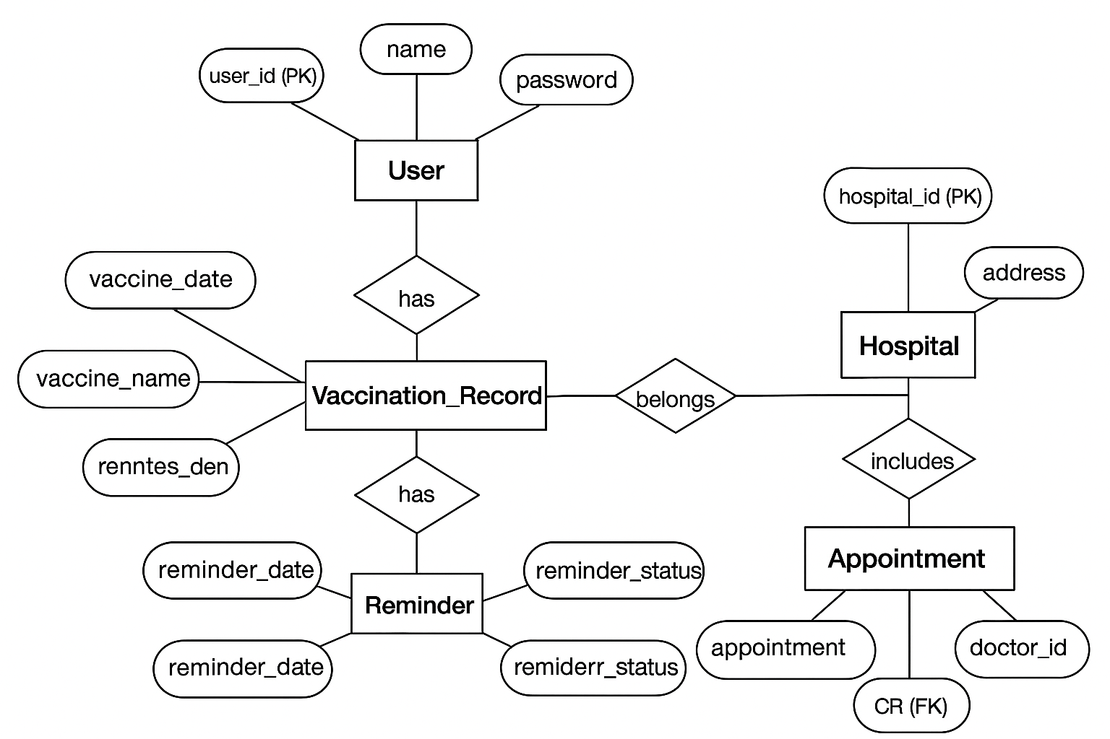
System Design & Implementation
ER Diagram

Slide 16
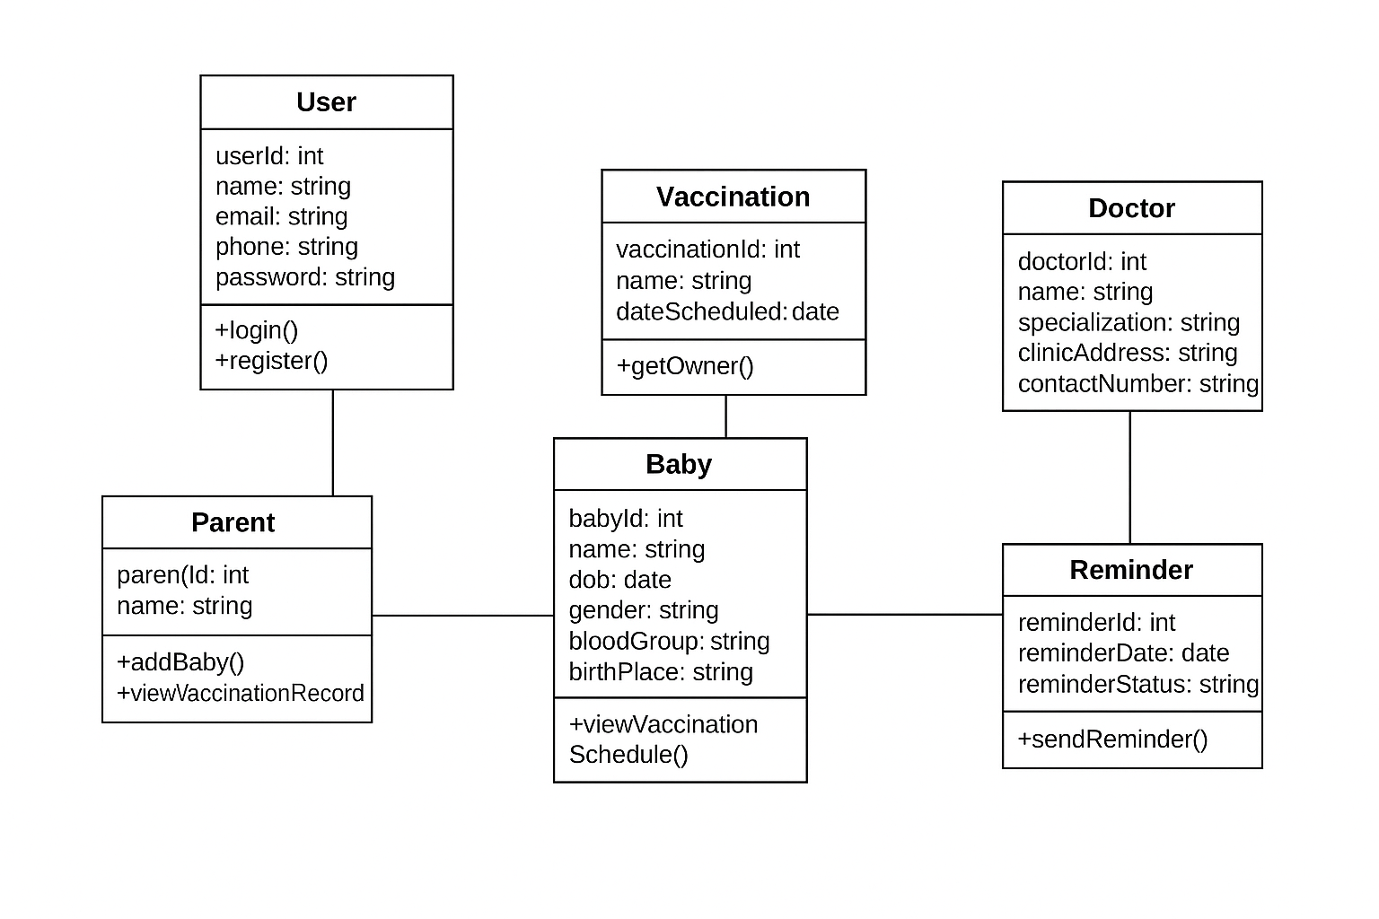
System Design & Implementation
Class Diagram

Slide 17
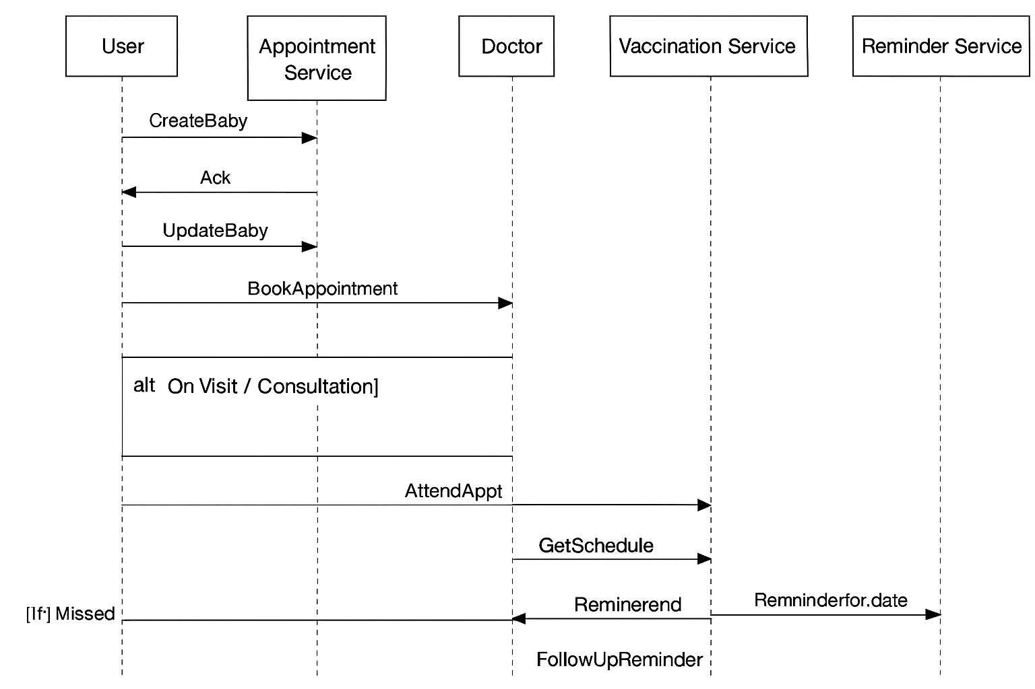
System Design & Implementation
Sequence Diagram

Slide 18
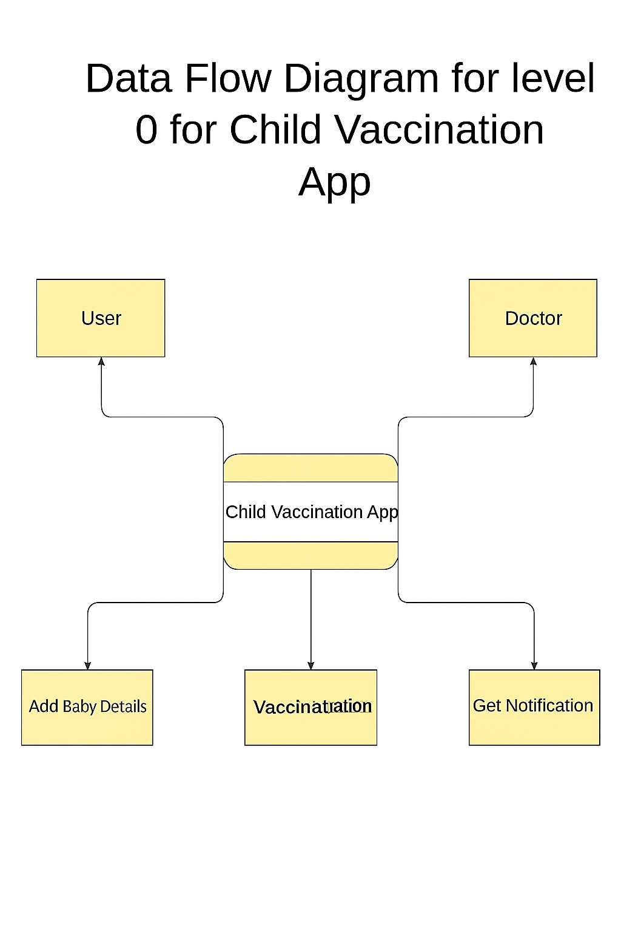
System Design & Implementation
DFD 0 level Diagram

Slide 19
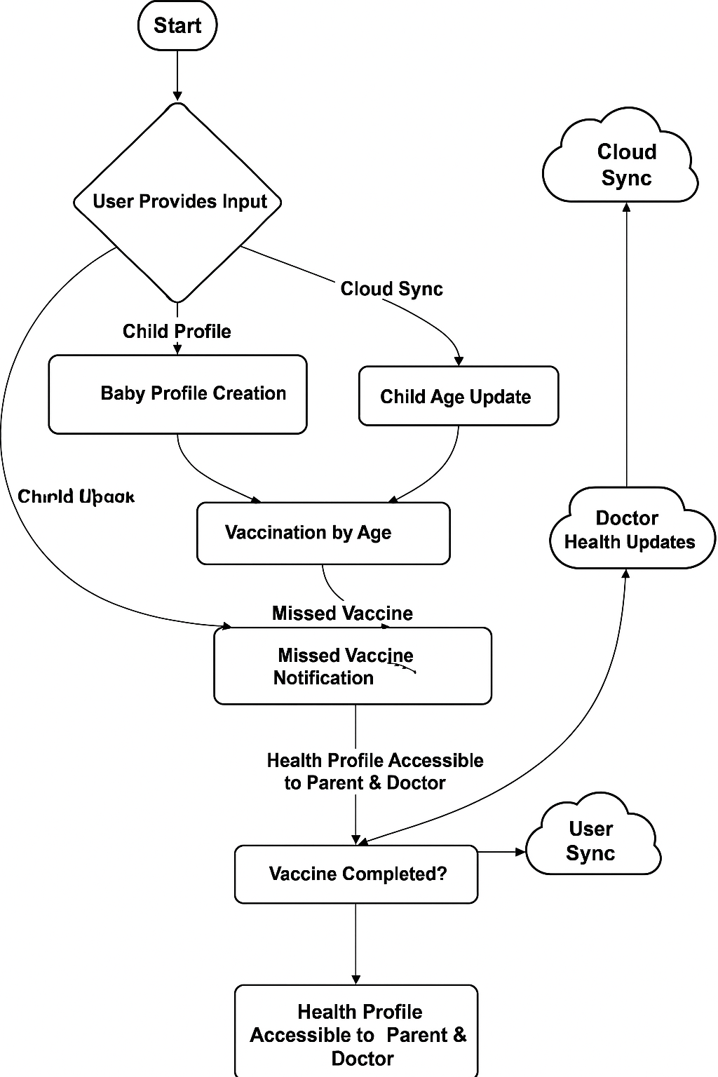
System Design & Implementation
Flowchart

Slide 20
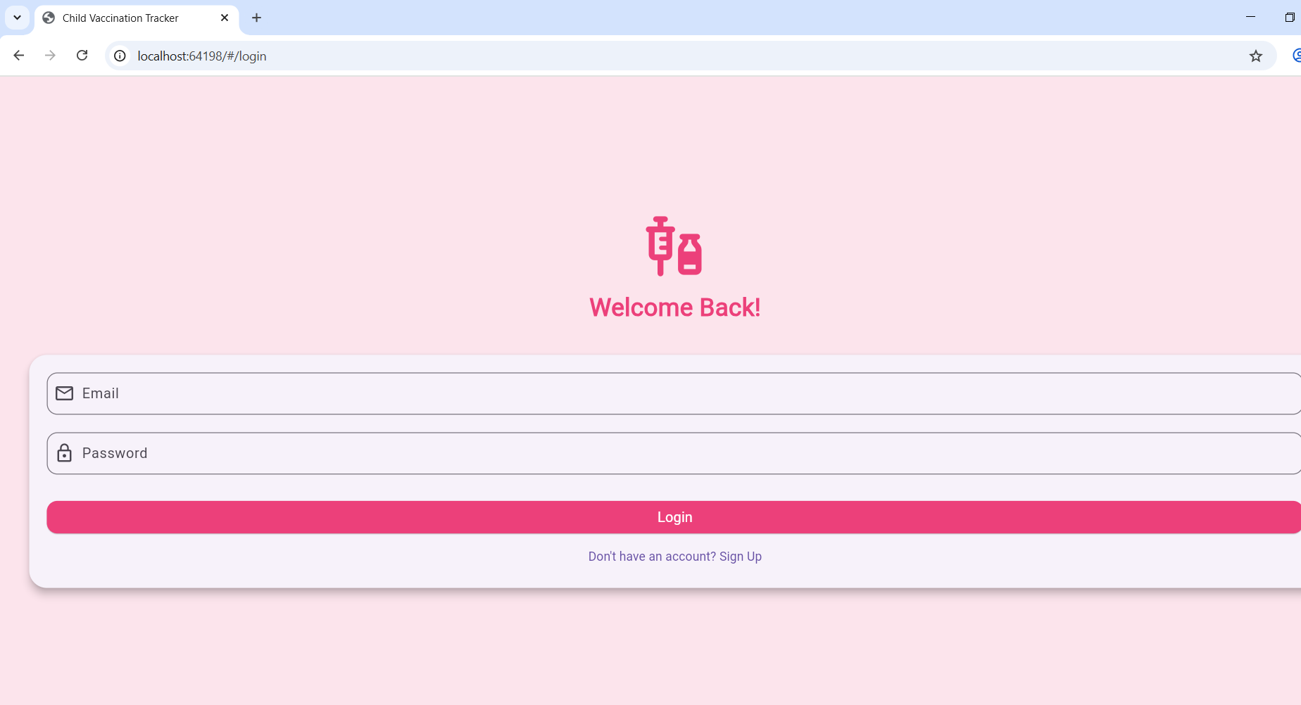
Implementation & Execution
Login Page

Slide 21
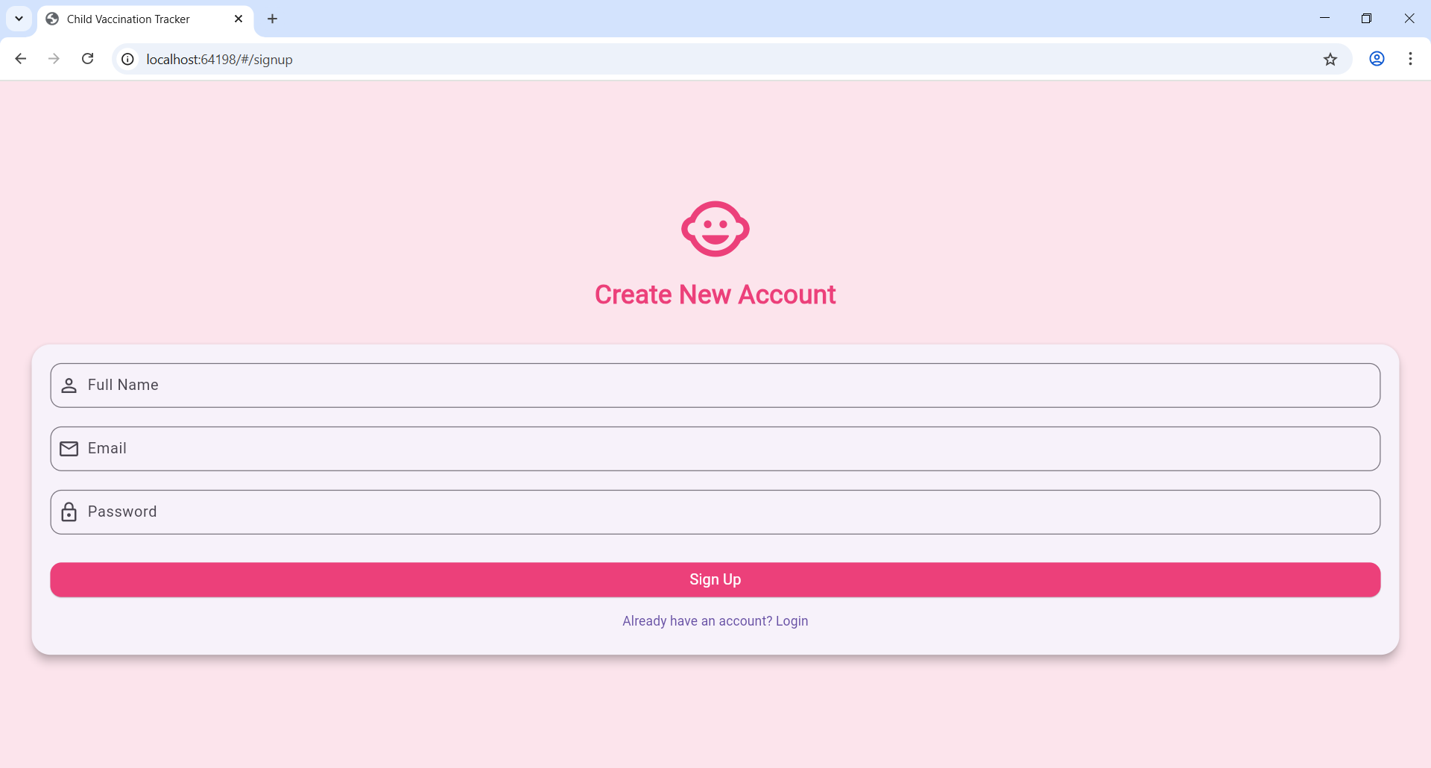
Implementation & Execution
Signup Page

Slide 22
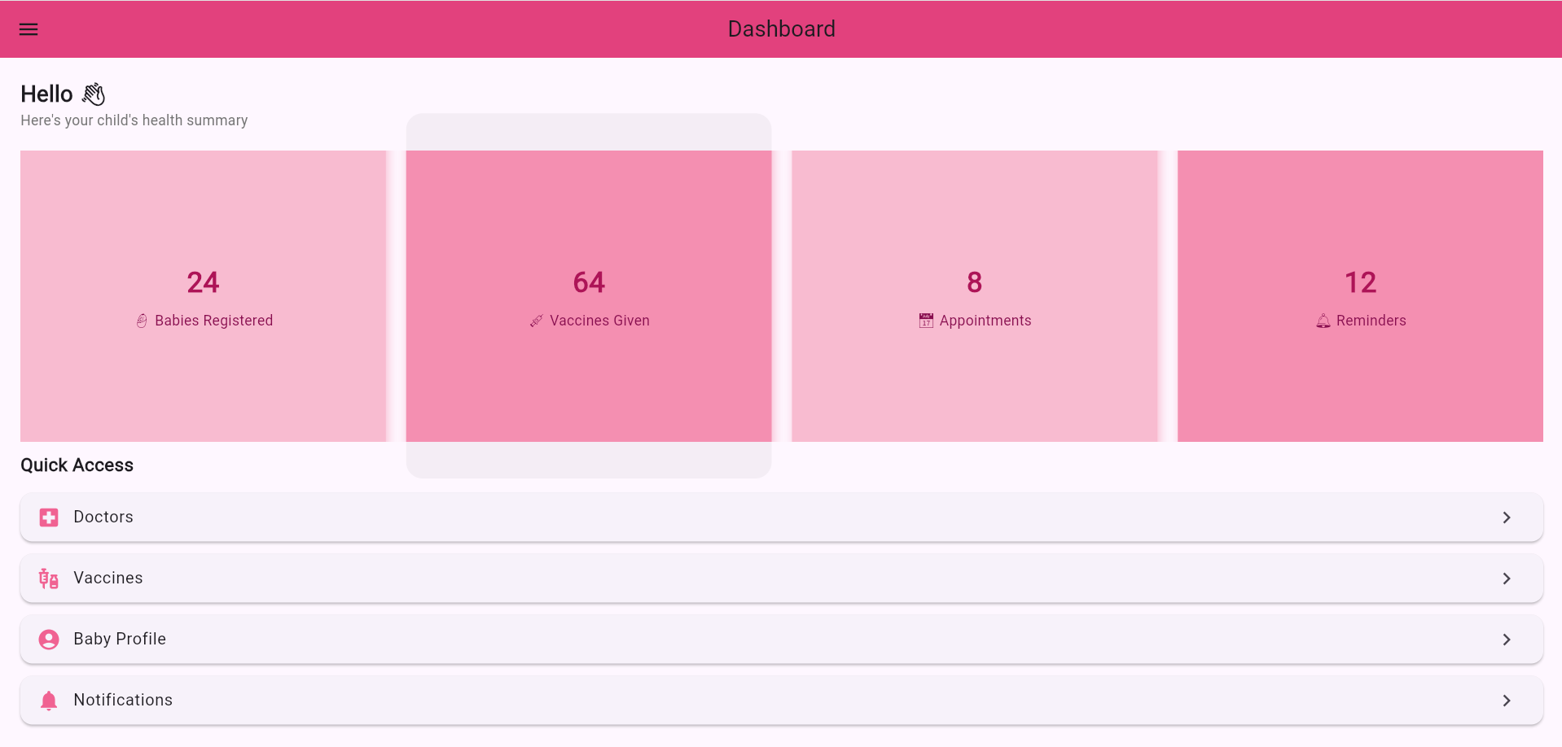
Implementation & Execution
Dashboard

Slide 23
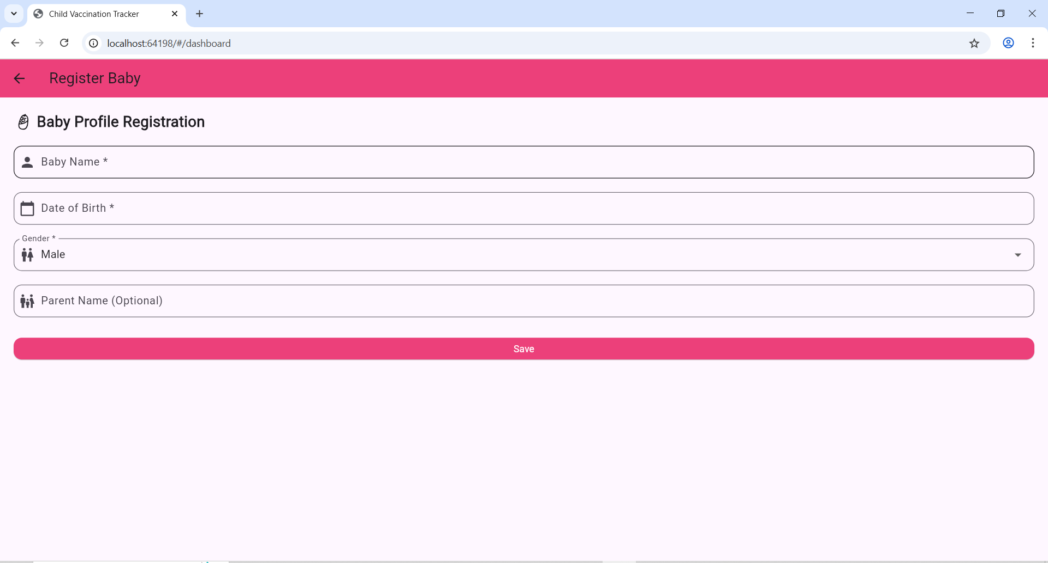
Implementation & Execution
Baby profile registration page

Slide 24
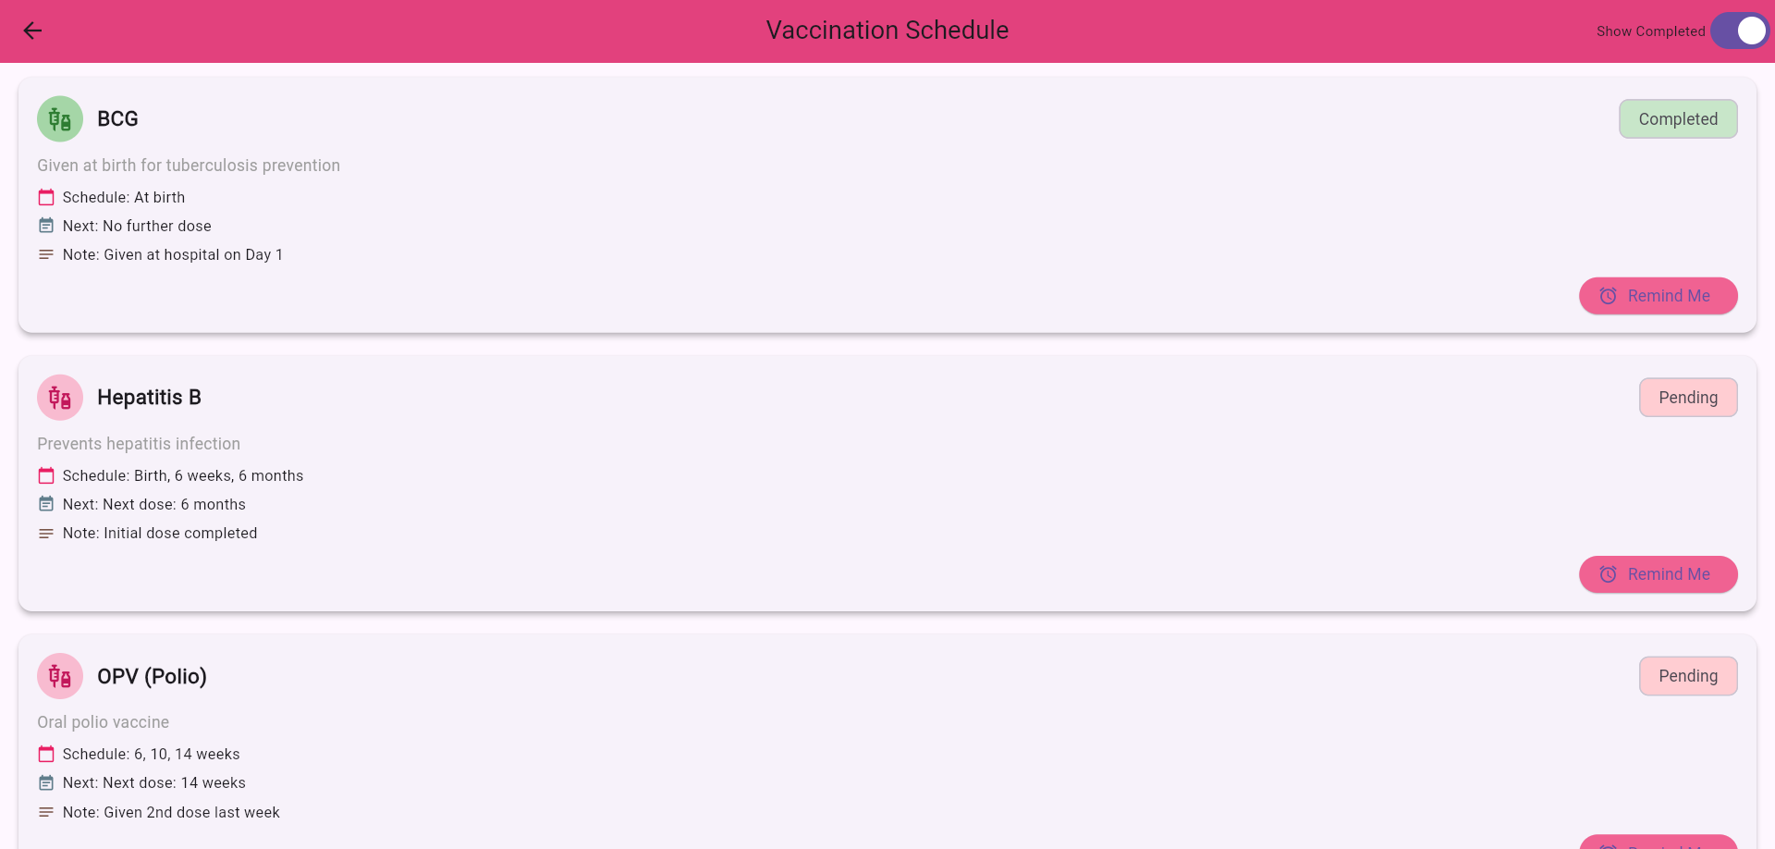
Implementation & Execution
Vaccination Schedule Page

Slide 25
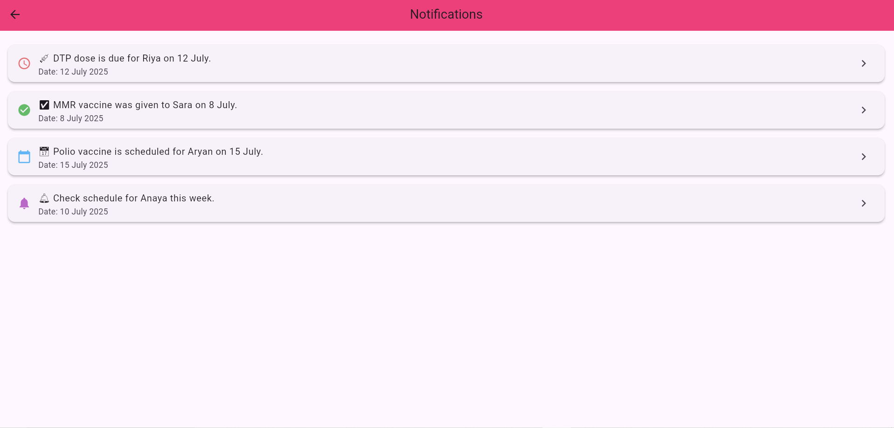
Implementation & Execution
Notifications Page

Slide 26
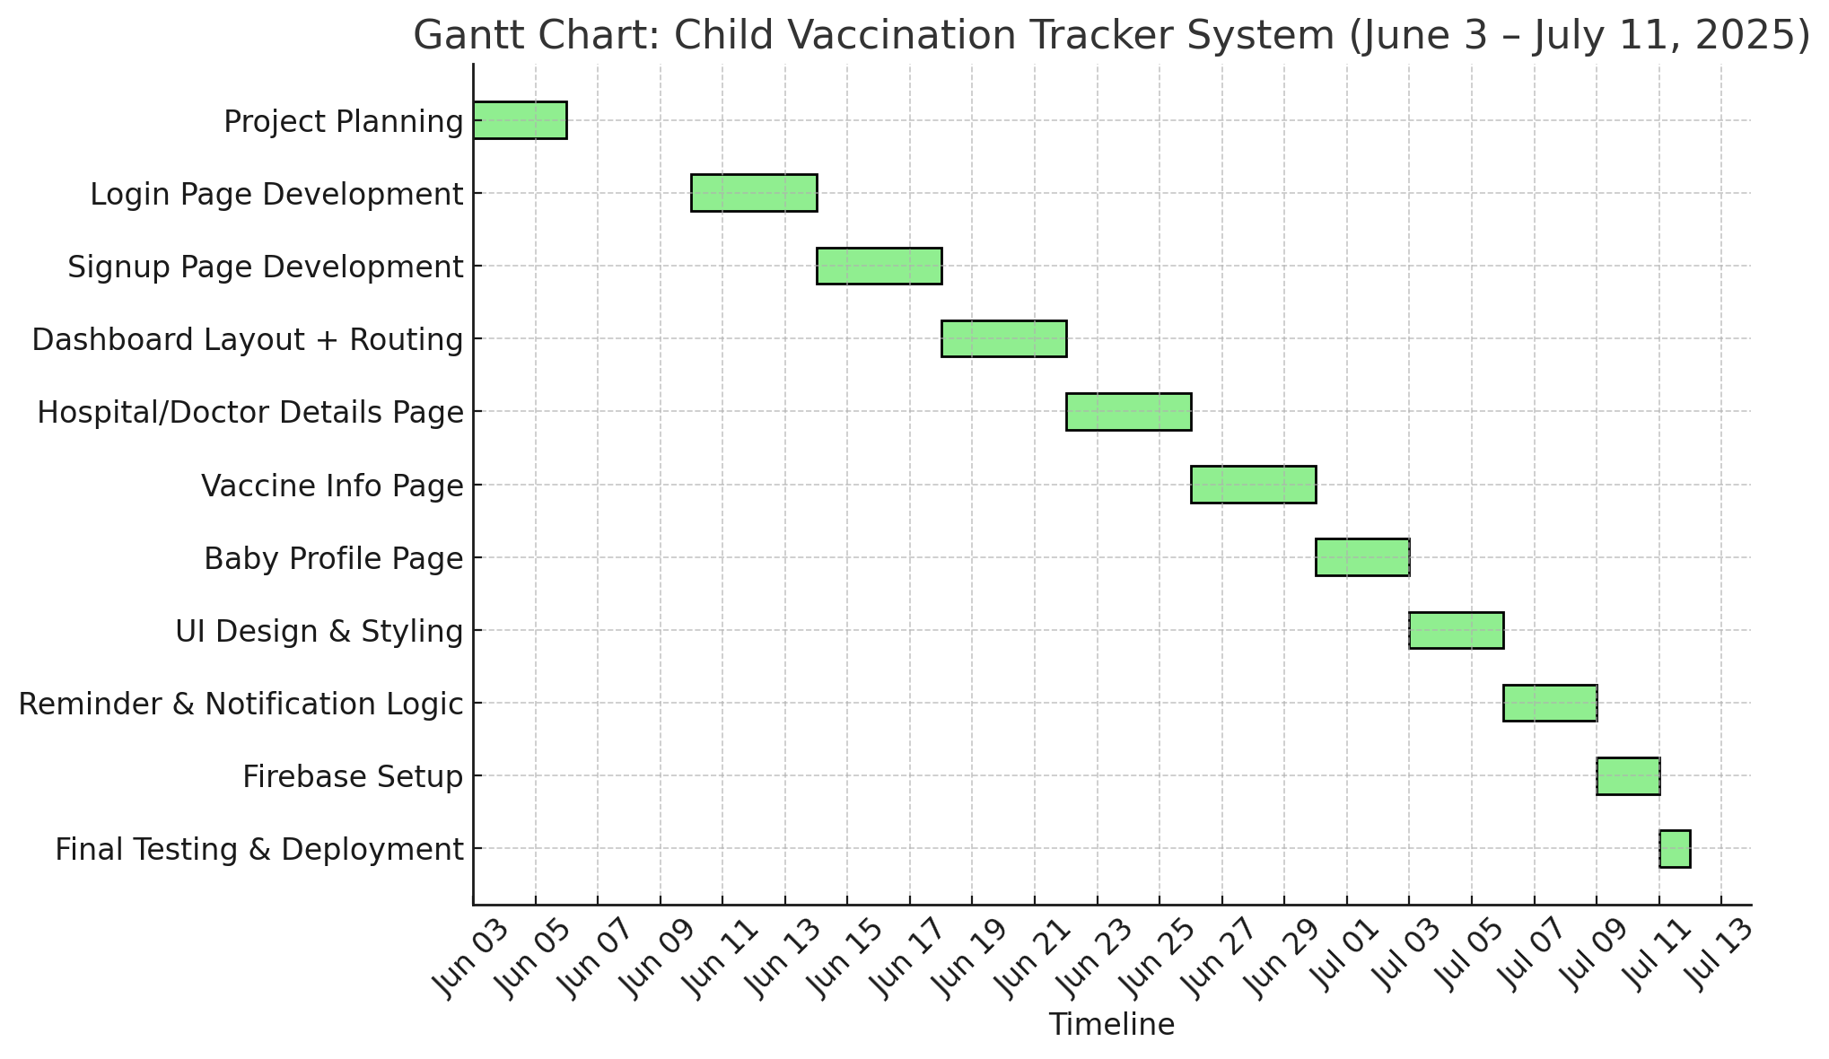
Flow with Planning and Scheduling
Gantt Chart

Slide 27
Expected Outcomes
Streamlined Vaccination Tracking
Efficiently manage and monitor each child's vaccination schedule with automated status updates (Due, Upcoming, Completed).
Responsive and Intuitive Dashboard
Offers real-time insights into total babies registered, vaccines given, upcoming doses, and reminders through a clean, user-friendly UI.
Integrated Doctor & Hospital Information
Displays doctor profiles with relevant contact and vaccine assignment details for better coordination and trust.

Slide 28
Expected Outcomes
Smart Notifications & Reminders
Real-time alerts and reminders for parents using Firebase and local notification systems, ensuring timely vaccinations.
Cloud-Based Data Management with Firebase
Secure authentication and real-time data storage using Firebase Firestore, enabling scalability and consistent access across platforms.

Slide 29
References
Stack Overflow
https://stackoverflow.com
2. Dart Packages (Pub. Dev)
https://pub.dev
3. Flutter Packages
https://pub.dev

Slide 30
Conclusion
The Child Vaccination Tracker System is a smart and user-friendly platform that helps parents and healthcare providers keep track of children’s vaccination schedules.
With real-time updates, secure login, and organized data through Firebase, the system ensures timely immunizations and reduces the risk of missed vaccines.
It improves health awareness and makes vaccination tracking easier and more efficient.

Slide 31


